Slide 1
Olecranon fractures
Nyakure

Slide 2
Epidemiology
bimodal distribution
high energy injuries in the young
low energy falls in the elderly
Pathophysiology
mechanism
direct blow
usually results in comminuted fracture
indirect blow
fall onto outstretched upper extremity
usually results in transverse or oblique fracture

Slide 3
Mechanism
Direct blow: This can happen in a fall (landing directly on the elbow) or by being struck by a hard object (baseball bat, dashboard of a car during a crash).
Indirect fracture: This can happen by landing on an outstretched arm. The person lands on the wrist with the elbow locked out straight. The triceps muscle on the back of the upper arm help "pull" the olecranon off of the ulna.

Slide 4
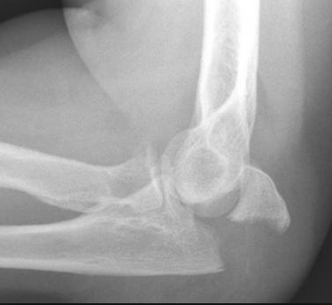
Image

Slide 5
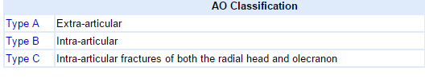
Classification

Slide 6
Other classifications
Mayo: Based on fracture displacement, comminution and dislocation
Colton: fracture type, comminution and dislocation
Schatzker: classified according to simplicity or complexity

Slide 7
Clinical features
Symptoms
pain well localized to posterior elbow
Physical exam
palpable defect
indicates displaced fracture or severe comminution
inability to extend elbow
indicates discontinuity of triceps (extensor) mechanism

Slide 8
Clinical features
Sudden, intense pain
Inability to straighten elbow
Swelling over the bone site
Bruising around the elbow
Tenderness to the touch
Numbness in one or more fingers
Pain with movement of the joint

Slide 9
Imaging
Radiographs
recommended views
AP/lateral radiographs
true lateral essential for determination of fracture pattern
additional views
radiocapitellar may be helpful for
radial head fracture
capitellar shear fracture
CT
may be useful for preoperative planning in comminuted fractures

Slide 10
Treatment
Nonoperative
immobilization
indications
nondisplaced fractures
displaced fracture is low demand, elderly individuals
technique
immobilization in 45-90 degrees of flexion for 3-4 weeks
begin motion at 3-4 weeks

Slide 11
Treatment: operative
tension band technique
indications
transverse fracture with no comminution
outcomes
excellent results with appropriate indications
intramedullary fixation
indications
transverse fracture with no comminution (same as tension band technique)
plate and screw fixation
indications
comminuted fractures
Monteggia fractures
fracture-dislocations
oblique fractures that extend distal to coronoid

Slide 12
Operative treatment
excision and triceps advancement
indications
elderly patients with osteoporotic bone
fracture must involve <50% of joint surface
nonunions
outcomes
salvage procedure that leads to decreased extension strength
may result in instability if ligamentous injury is not diagnosed before operation

Slide 13
Complications
Symptomatic hardware
most frequent reported complication
Stiffness
occurs in ~50% of patients
usually doesn't alter functional capabilities
Heterotopic ossification
more common with associated head injury
Posttraumatic arthritis
Nonunion
rare
Ulnar nerve symptoms
Anterior interosseous nerve injury
Loss of extension strength

